Slide 1
Coresets Meet EDCS
Study Group
March 4, 2019

Slide 2
Today’s Goal
To eat well and drink well
To understand the contribution and main results of SODA19
To get a feel on distributed, MPC, and streaming models
Only very high-level ideas for intuition
Details in later weeks

Slide 3
Why Pick SODA19?
What’s the criteria for “good” algorithms?

Slide 4
Scalable
General
Unified framework
Robust/Good Theoretical guarantee
… also time and space efficient
… and also quite simple!

Slide 5
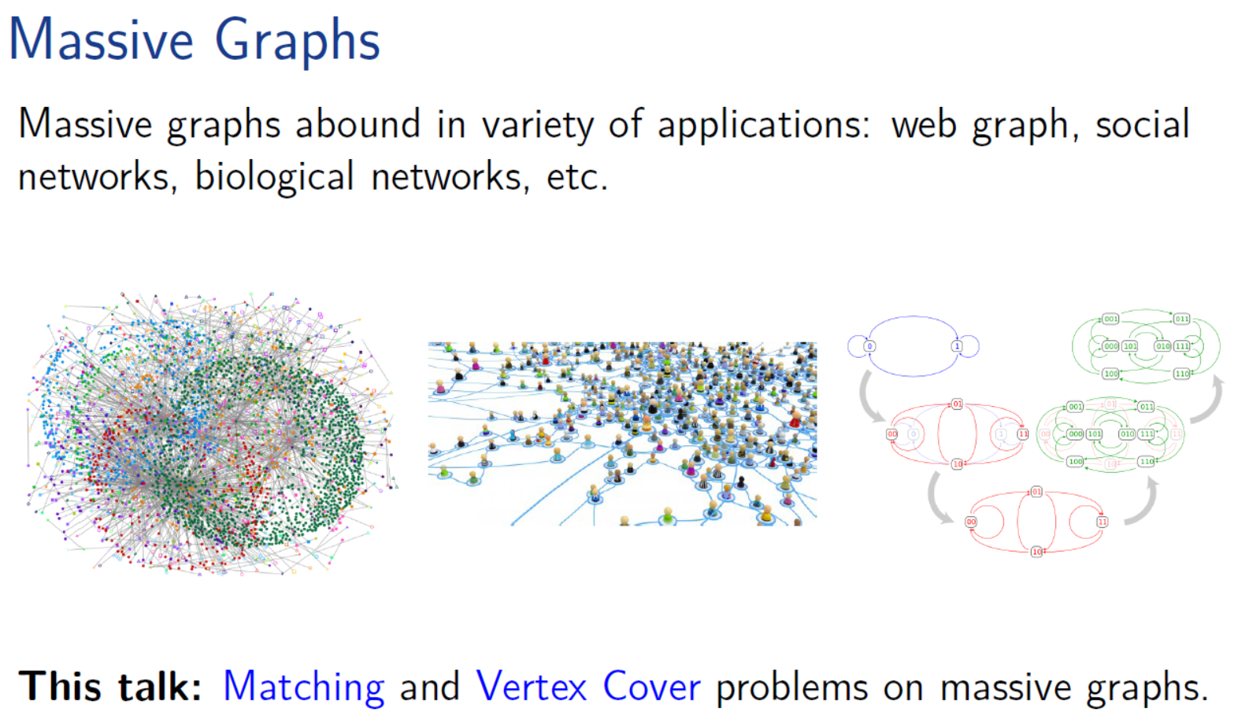

Slide 6
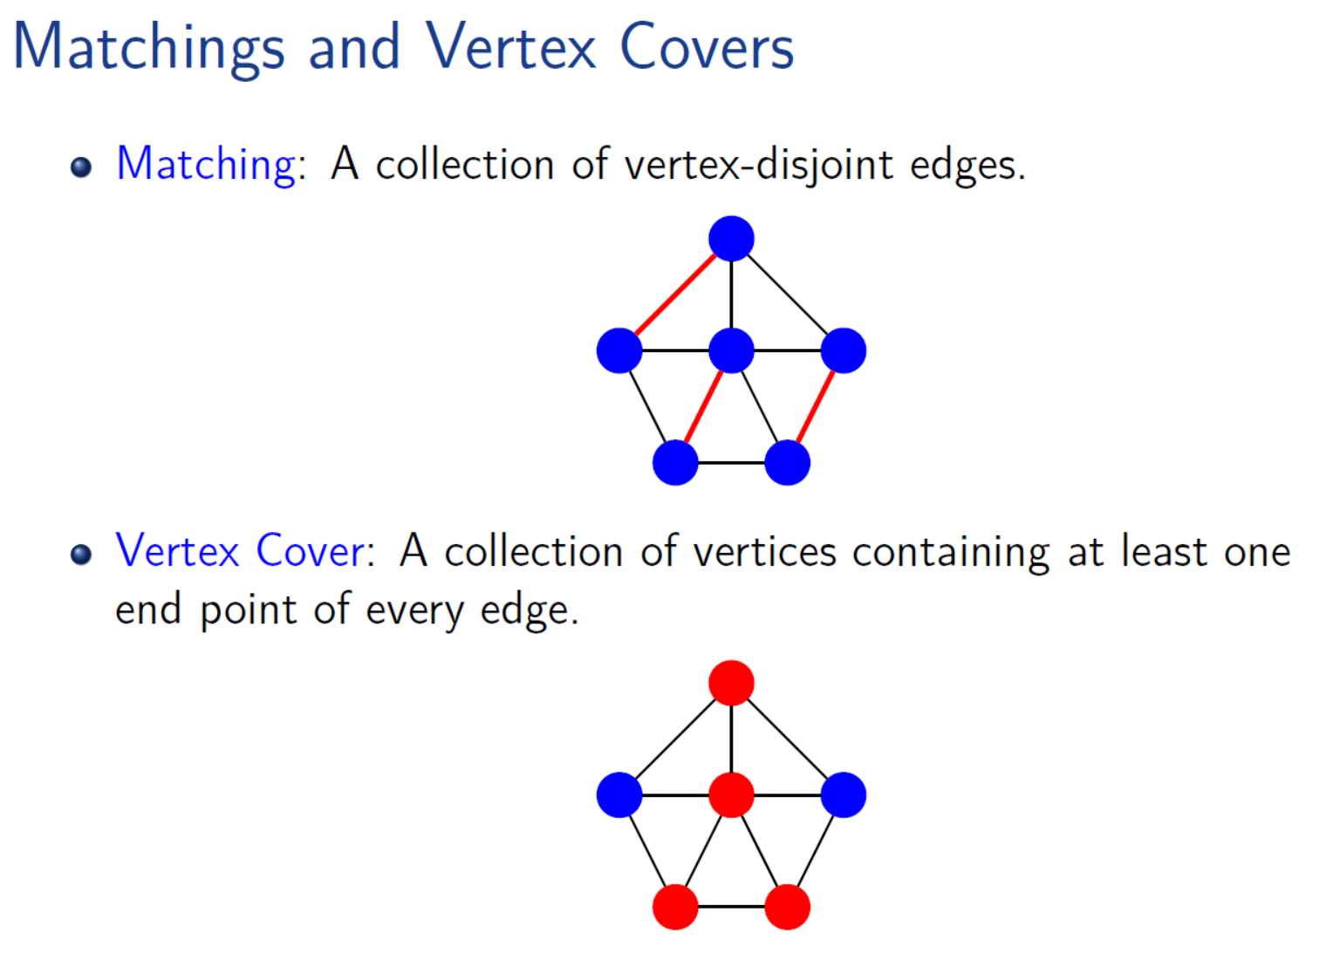
Maximum Matching
Maximal Matching
Minimum Vertex Cover

Slide 7
Drink Time
Everyone cooperates to get your favorite drink!
1. Compose Max. Matching into Matching
2. Compose EDCS into Matching

Slide 8
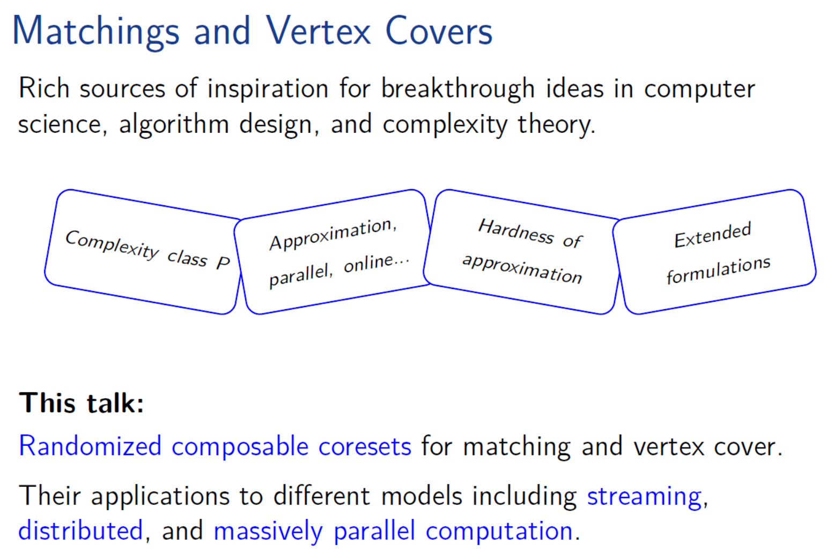

Slide 9
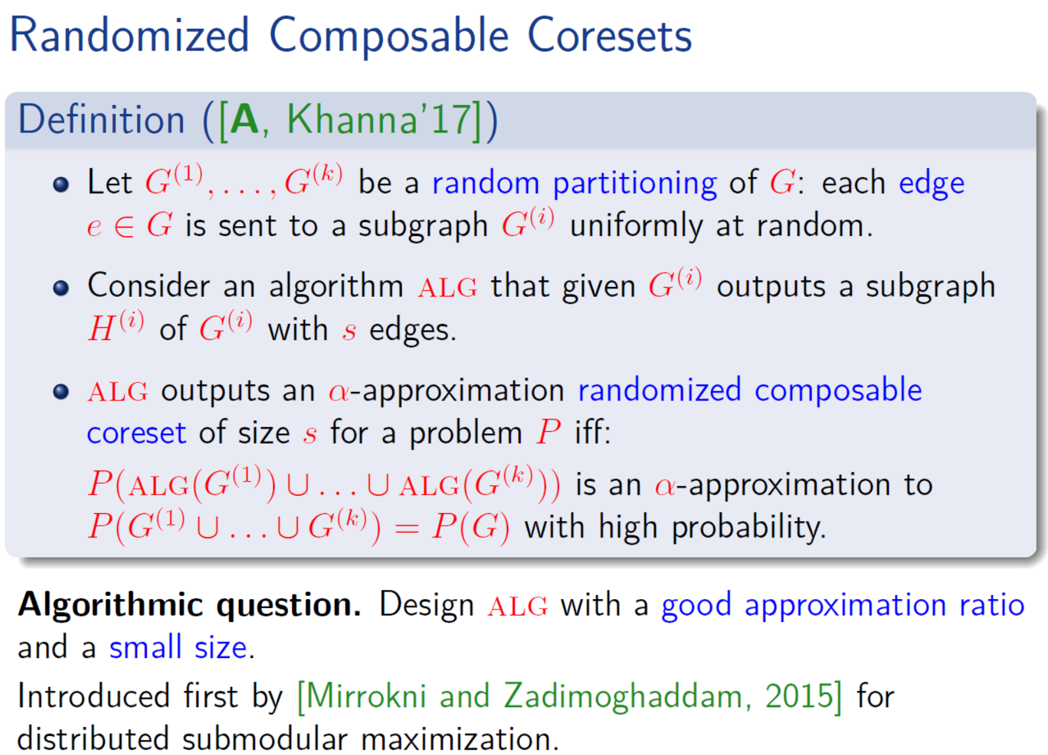

Slide 10
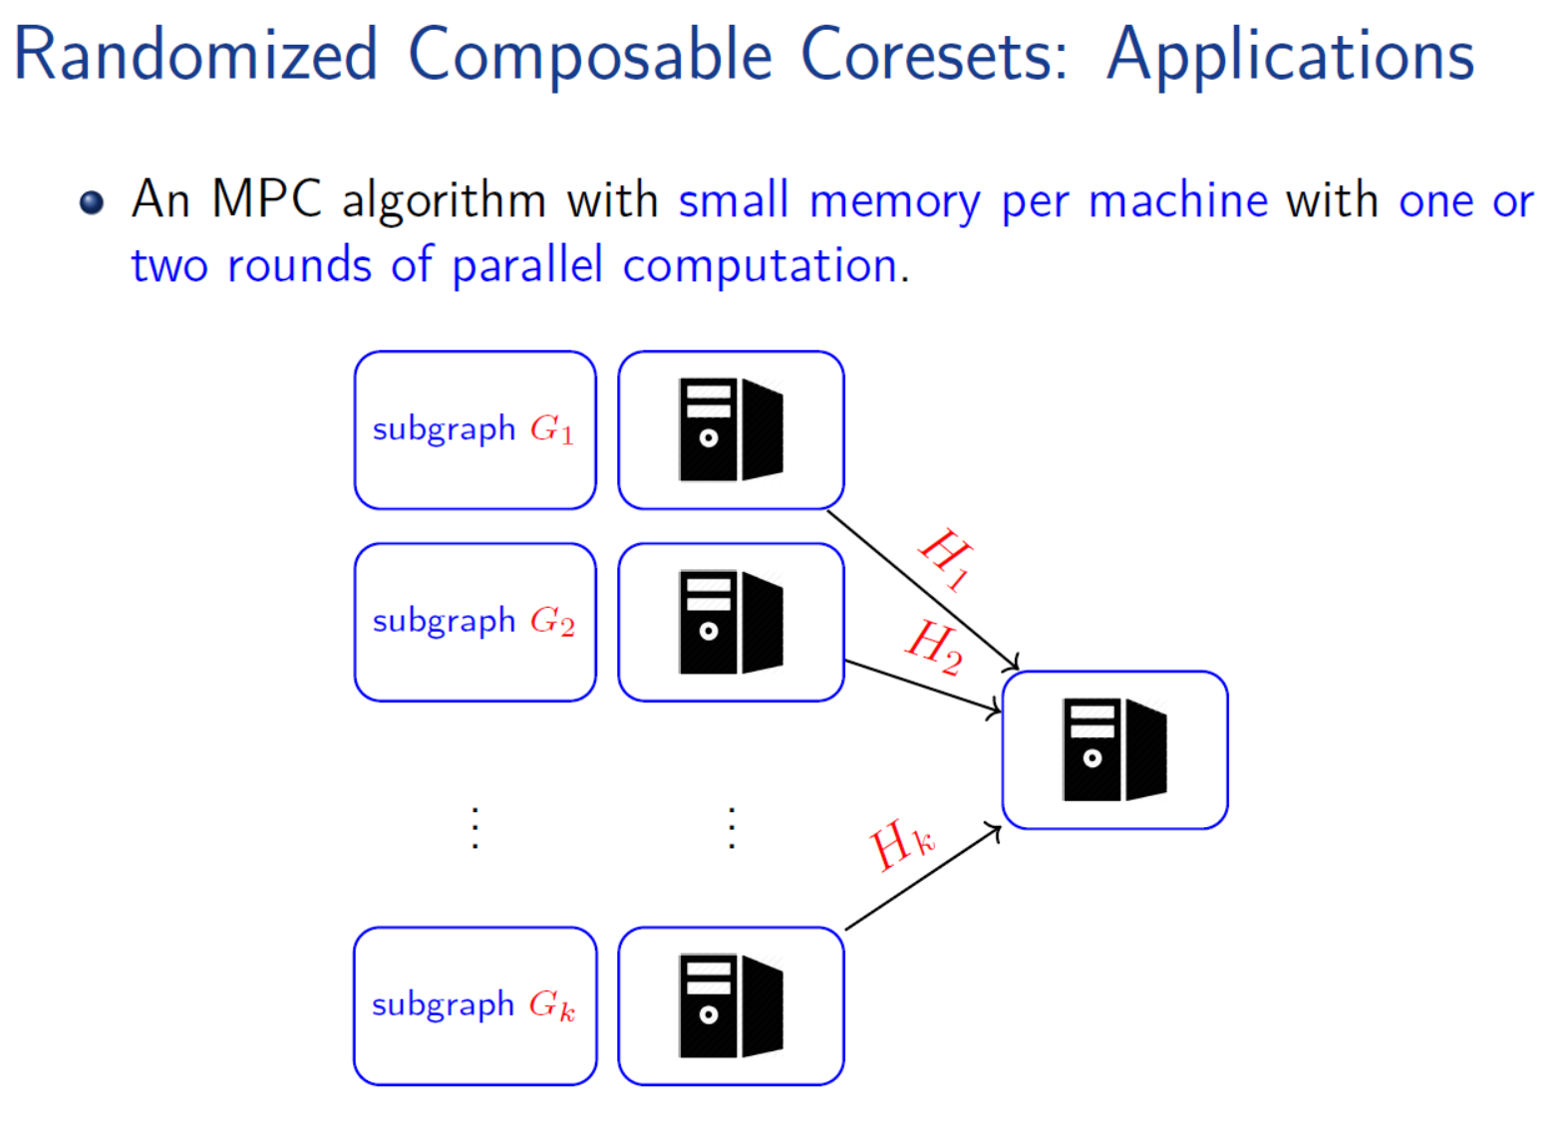

Slide 11
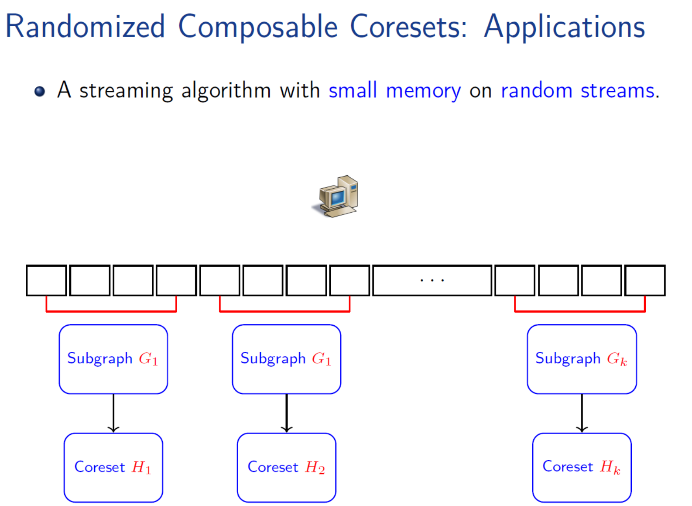

Slide 12
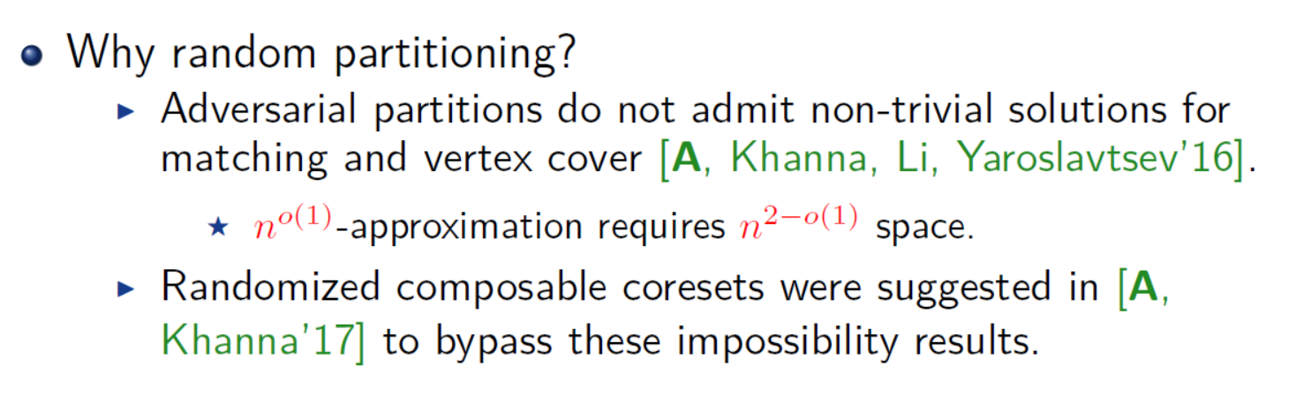

Slide 13
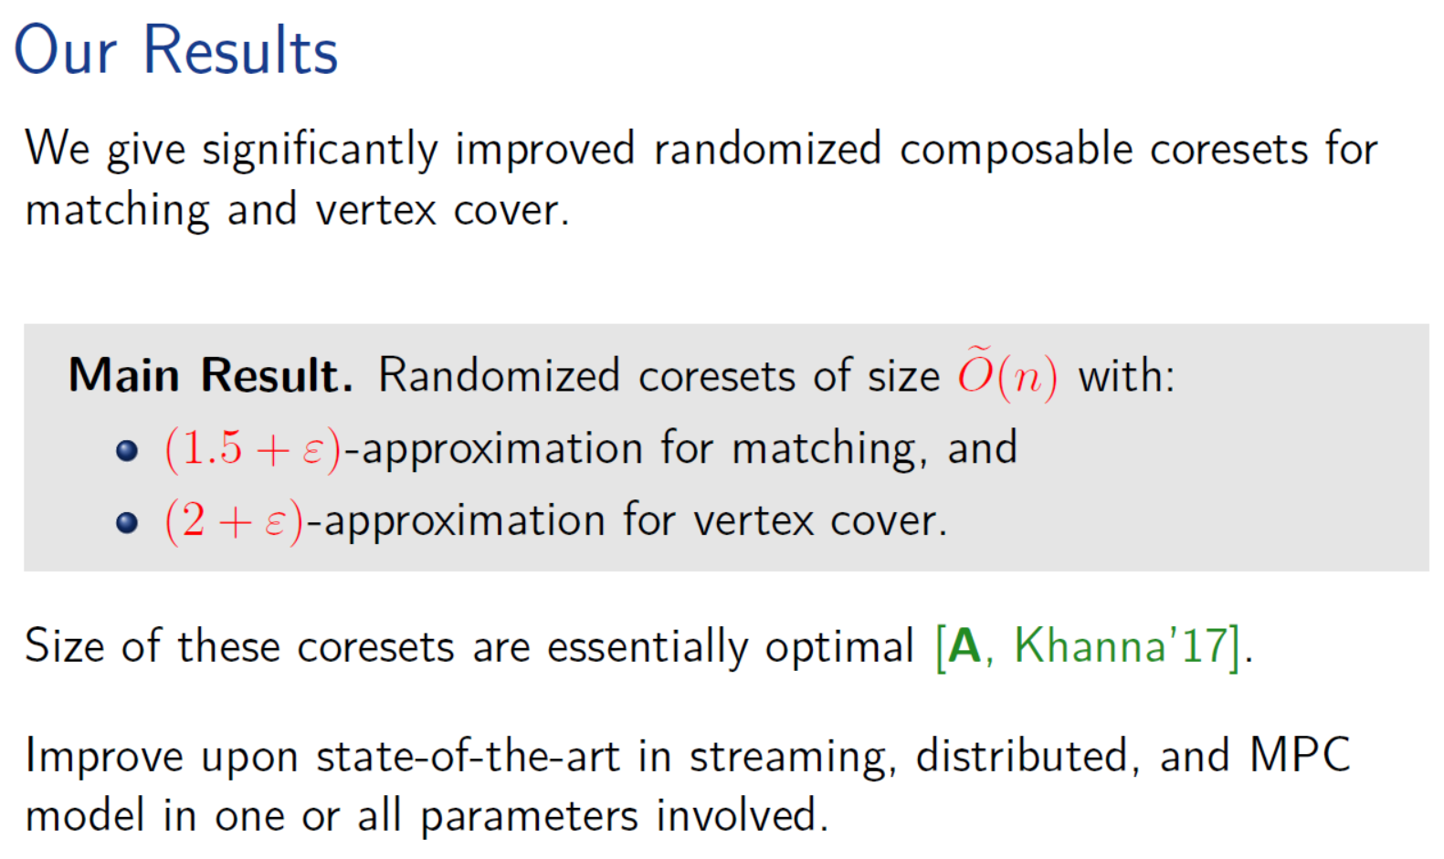

Slide 14
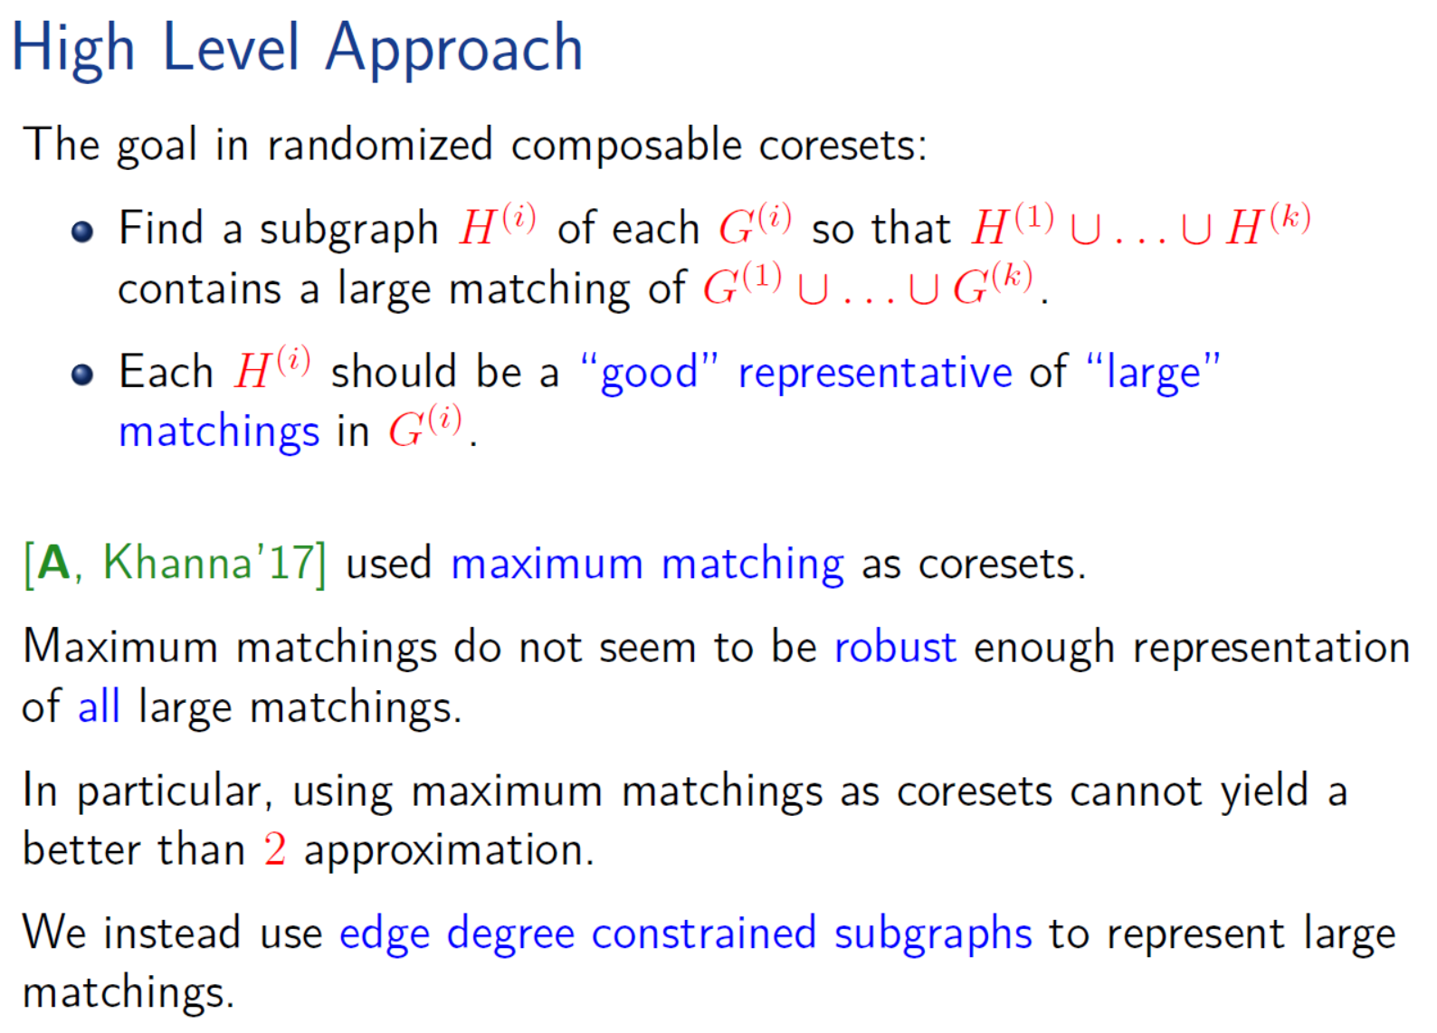

Slide 15
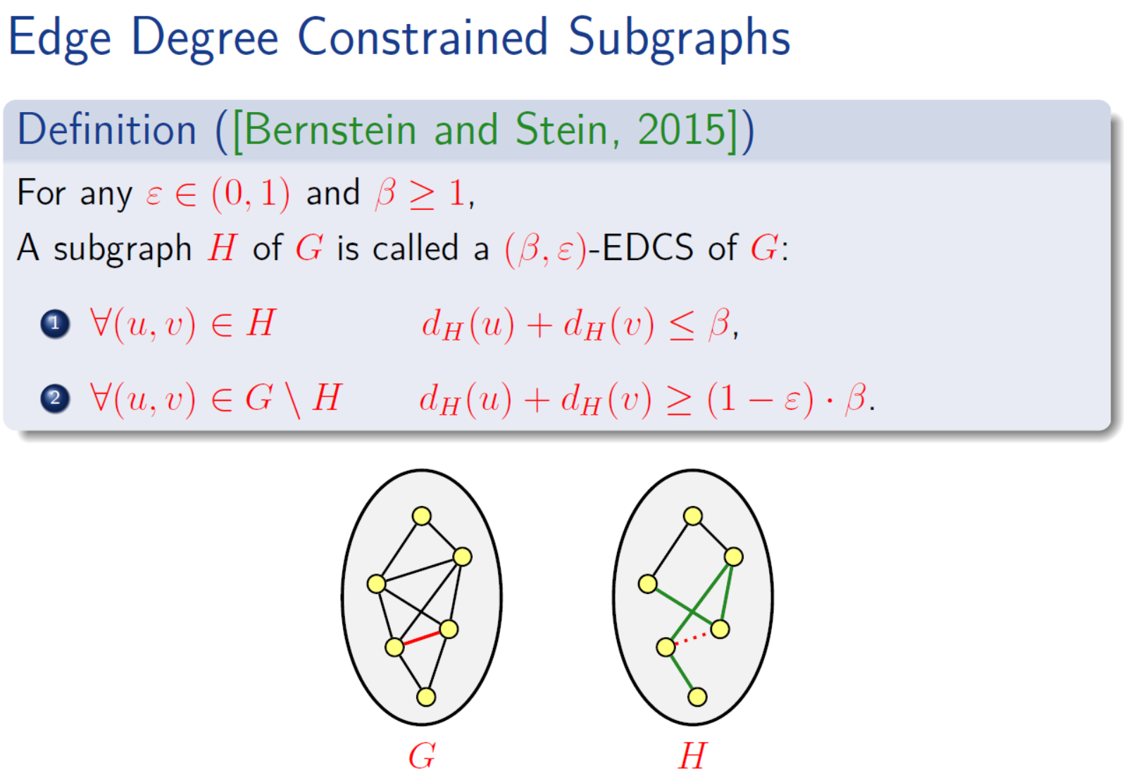

Slide 16
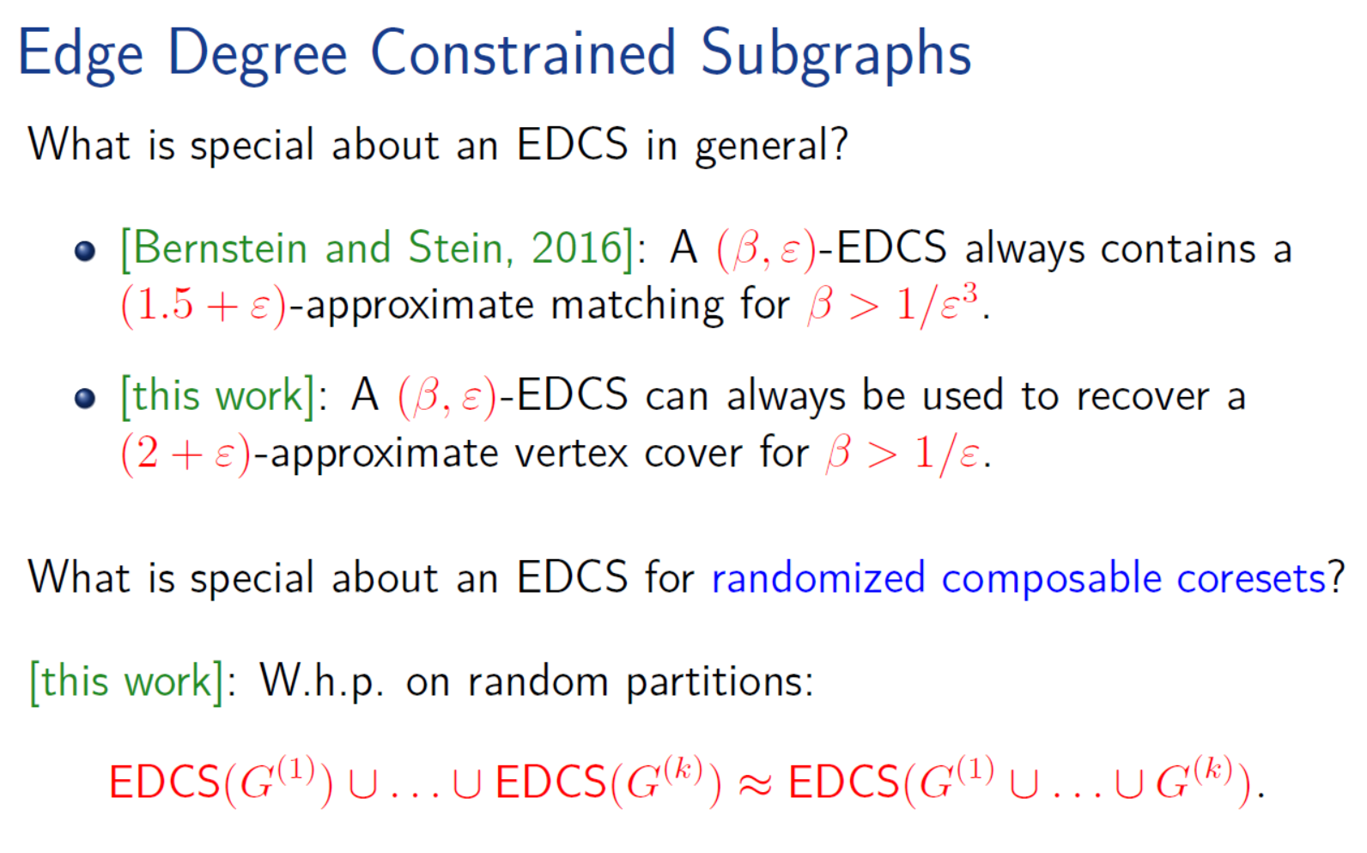

Slide 17
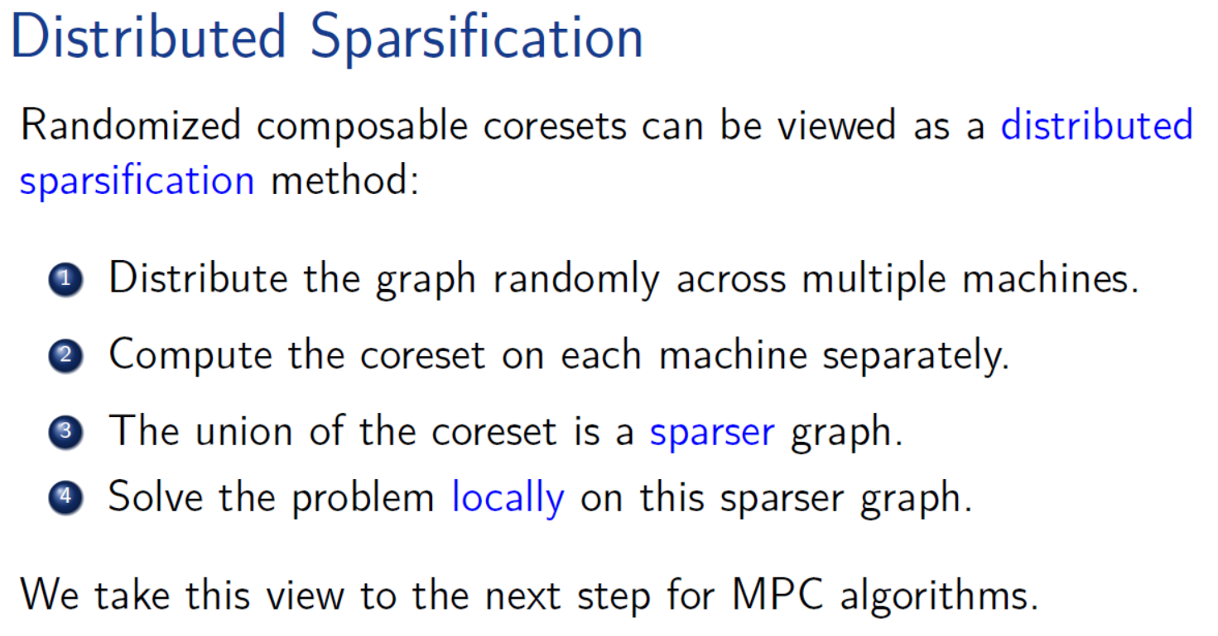

Slide 18
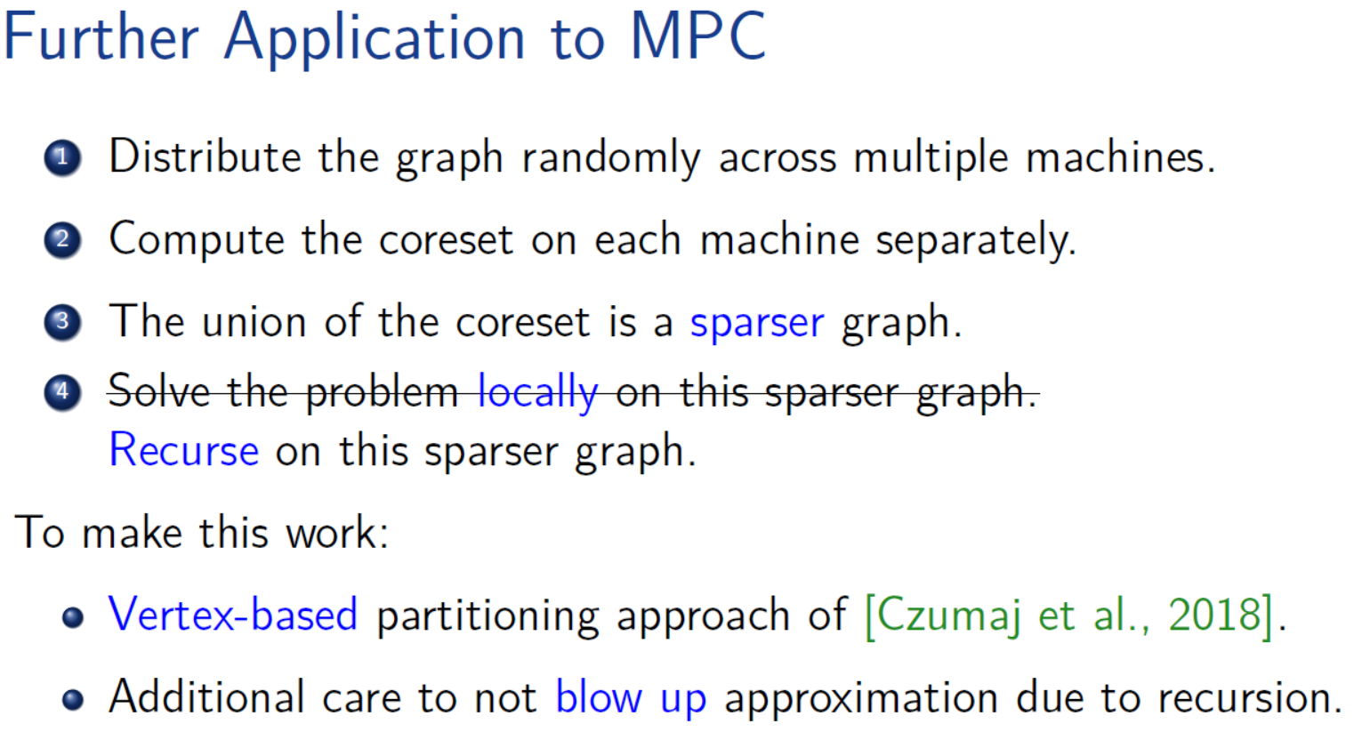
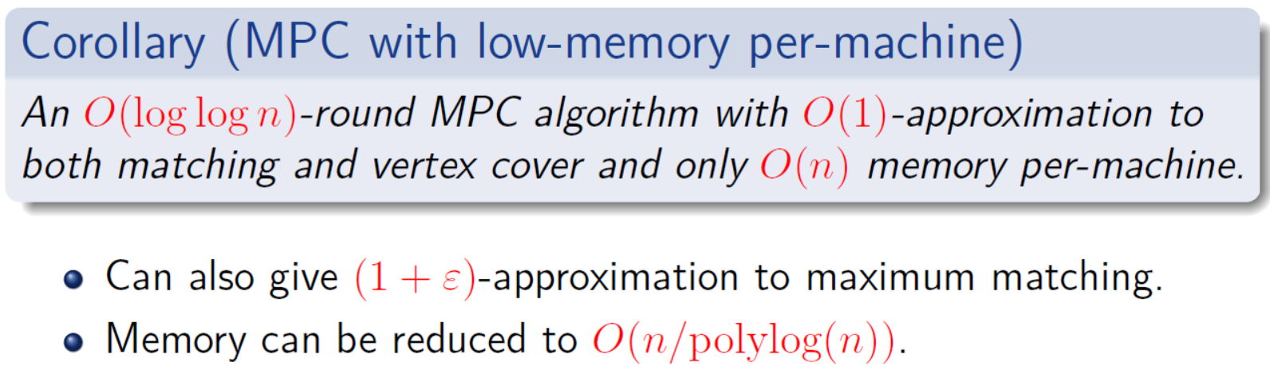

Slide 19
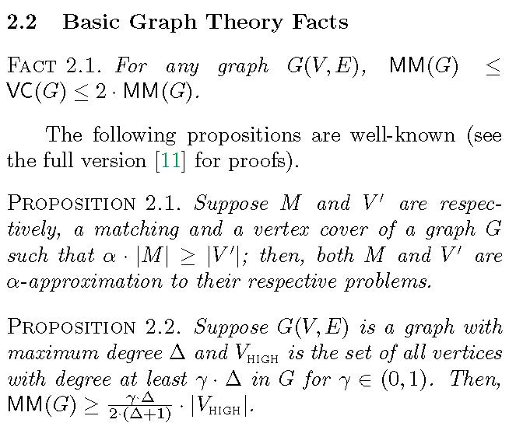
Get more feel about MM and VC

Slide 20
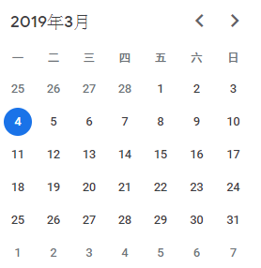
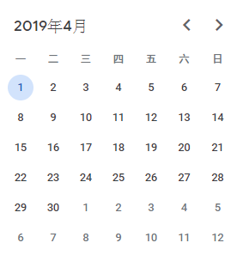
Misc
Next meetings
Randomized Composable Coresets? EDCS?
Date
Volunteers

